Slide 1
Resource Pack: Interaction II Evaluation and Testing
© Melanie Baljko

Slide 2
Intellectual Property Notice
This presentation is protected by Canadian and international copyright laws. Reproduction and distribution of the presentation without the written permission of the copyright holder is prohibited.
These course materials are designed for use as part of the EECS3461 course at York University and are the intellectual property of the instructor unless otherwise stated. Third party copyrighted materials (such as book chapters, journal articles, music, videos, etc) have either been licensed for use in this course or fall under an exception or limitation in Canadian Copyright law.
Copying this material for distribution (e.g., uploading material to a commercial third-party website) may lead to a charge of misconduct under York’s Code of Student Rights and Responsibilities and the Senate Policy on Academic Honesty and/or legal consequences for violation of copyright law if copyright law has been violated.
© Melanie Baljko, 2021

Slide 3
Dependencies
This resource pack assumes that you are already familiar with:
R-Humans-I
R-Design-V (and all previous)
R-Interaction I

Slide 4
Inquiry
Break down this resource pack into smaller pieces
1. What is meant by evaluation?
2. Recap of the position of evaluation in the design process.
3. What is heuristic evaluation?
4. How do we evaluate usefulness?
5. What is meant by an affordance?
6. What is usability and how do we evaluate it?

Slide 5
1. What is meant by evaluation?

Slide 6
What is meant by evaluation?
Evaluation is a systematic determination of the degree to which a subject has met a particular set of criteria.

Slide 7
What is meant by evaluation?
Evaluation is a systematic determination of the degree to which a subject has met a particular set of criteria.
There are many different types of subjects.
For instance…
design outcomes (e.g., the interactive system, the user experience)
knowledge outcomes (e.g., research results)
educational design outcomes (e.g., course designs, assessment activities)
social interventions (e.g., public health campaigns)
…

Slide 8
What is meant by evaluation?
Evaluation is a systematic determination of the degree to which a subject has met a particular set of criteria.
There are many different types of subjects.
For instance…
design outcomes (e.g., the interactive system, the user experience)
knowledge outcomes (e.g., research results)
educational design outcomes (e.g., course designs, assessment activities)
social interventions (e.g., public health campaigns)
…
There are many different systems for making determinations wrt criteria.
For instance…
critical analyses (e.g., applying sociological and other concepts in a line of argumentation)
empirical, quantitative approaches (e.g., scientific experiments)
empirical, qualitative approaches (e.g., interviews, questionnaires)
…

Slide 9
What is meant by evaluation?
Evaluation is a systematic determination of the degree to which a subject has met a particular set of criteria.
There are many different types of subjects.
For instance…
design outcomes (e.g., the interactive system, the user experience)
knowledge outcomes (e.g., research results)
educational design outcomes (e.g., course designs, assessment activities)
social interventions (e.g., public health campaigns)
…
There are many different systems for making determinations wrt criteria.
For instance…
critical analyses (e.g., applying sociological and other concepts in a line of argumentation)
empirical, quantitative approaches (e.g., scientific experiments)
empirical, qualitative approaches (e.g., interviews, questionnaires)
…
There are different types of criteria… and operationalized concepts

Slide 10
Criteria for Abstract Concepts
much of what we want to study concerns abstract concepts that are not directly measurable
Examples:
the concept of an interactive system being effective, efficient, safe, having utility, learnable, having memorability
the concept of user experience being pleasant, fun, inspirational, …
the concept of an interactive system being useful, helpful, providing value, perpetuating marginalization, …
the concept of an interactive system being market dominant, being an instrument of a regime, being a vehicle for propoganda

Slide 11
Abstract Concepts, Measurability
much of what we want to study concerns abstract concepts that are not directly measurable
Examples:
the concept of an interactive system being effective, efficient, safe, having utility, learnable, having memorability
the concept of user experience being pleasant, fun, inspirational, …
the concept of an interactive system being useful, helpful, providing value, perpetuating marginalization, …
the concept of an interactive system being market dominant, being an instrument of a regime, being a vehicle for propoganda
At the analytical level…
the individual level
the individual level
the individual level, the group level
the level of a large population, such as a nation or globally

Slide 12
The Micro, Meso, and Macro Levels
Sociologists investigate and understand human interaction at these different analytical levels:
micro-level: looking at the interactions of an individual in their social setting
meso-level: looking at the interactions within a group setting (e.g., workplaces, clubs, communities)
macro-level: looking at the effects and traces of interaction at the scale of a large population, such as a nation or globally

Slide 13
What is meant by operationalize?
operationalize means to express or define an abstract concept in terms of the operations used to determine it
operationalization is a concept in research design (among other domains)
we operationalize abstract concepts that are not directly measurable (and the concept becomes defined in terms of how it is measured)
the core concepts and their operationalizations vary among different research and design teams, there are different approaches

Slide 14
Example of operationalization
for instance…
the concept of efficiency may be the operationalized as number of operations required to complete a particular task
recall: motivations → goals → activities → tasks → operations
e.g., in a word processor, the number of keystrokes required to search and replace all instances of a string
if efficiency gets operationalized in this way, and if efficiency is important in the design domain, then this impacts the criteria for evaluation
e.g., “number of operations per task” gets used as an outcome measure, it becomes a criterion in evaluation

Slide 15
2. What is the position of evaluation in the design process?

Slide 16
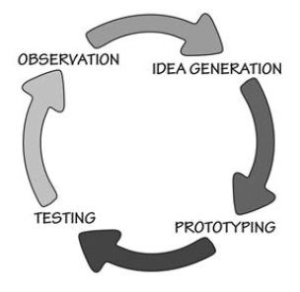
Four Core Activities
the output of one activity generally feeds into the next activity
Research (Observing/Establishing requirements)
Generating Ideas/Designing alternatives
Evaluating/Testing
Prototyping

Slide 17
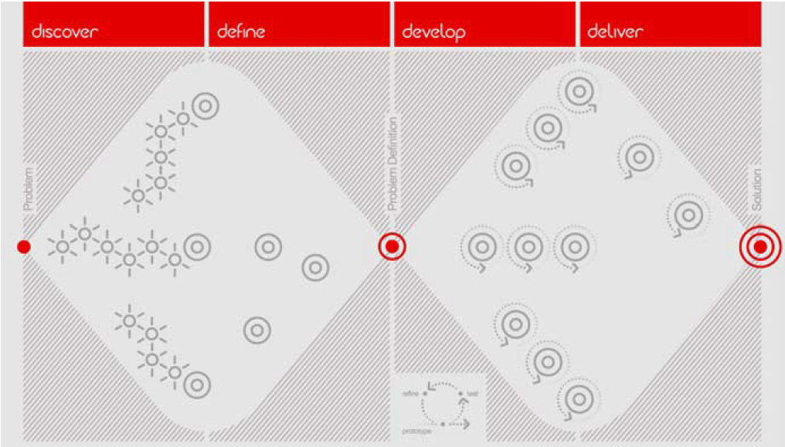
The Double Diamond design process model
successive iterations of core activities

Slide 18
Position of Evaluation in the Design Process
Evaluation is one of the four core activities in the design process
It is an activity carried out repeatedly (on prototypes that evolve and are successively refined)
The criteria for evaluation are derived from (informed by) the design brief (or other such artefact, such as problem definition)
The design brief is central, it informs the entire process:
Ideation and Prototyping involve the use of design principles that are applied prospectively
Evaluation involves criteria that are applied retrospectively

Slide 19
3. What is heuristic evaluation?

Slide 20
Human-Centered Design, Philosophy
Textbook, Sharp et al, 2019, sec 2.2.4
Recall the three core principles in HCD:
employ an iterative approach
the focus on users must come in the early, not late, iterations
decisions should be made empirically
Thus, evaluation should involve:
interaction with users, and/or
direct observation of users

Slide 21
What is Heuristic Evaluation?
In HCD, evaluation should involve:
interaction with users, or
direct observation of users
However, there are some approaches to evaluation do not require users to be present during the evaluation
These methods are based on knowledge of users
this knowledge is then codified into heuristics that are used as the basis for predicting user outcome
given a prototype, apply heuristics retrospectively to obtain evaluation

Slide 22
Linked: Heuristic Evaluation and Design Principles
Notice the linkage…
knowledge of users codified into heuristics
given a prototype, apply heuristics retrospectively to obtain evaluation
knowledge of users codified in design principles
given an ideation and/or prototyping scenario, apply design principles prospectively to propel design process forward

Slide 23
Status of Heuristic Evaluation
if a design processes employs only heuristic evaluation, then it is not HCD
Human Centered Design (HCD) means, among other things, that design decisions are being made on the basis of empirical data
However…
heuristic evaluation approaches can be useful
knowledge of heuristic evaluation approaches also connected to design principles

Slide 24
4. How do we evaluate usefulness?
What is the difference between useful and usable? (conceptual foundation of usefulness) Does the designer determine usefulness?

Slide 25
Useful vs Usable
can an interactive system be useful but not usable?
can an interactive system be usable but not useful?
to what extent do the actions of the designer determine usefulness?

Slide 26
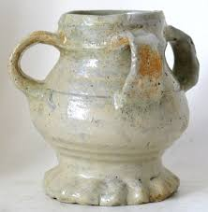
Is this useful?
Case #1
Notes:
the tyg, a multi-handled drinking cup popular in 18th century England.
clearly utilitarian, very practical.
makes it easy to pass a hot cup, for example, form one person to another, where both giver and receiver will have conveniently placed handles to hold, so that neither party will burn themselves.
if multiple people drink from the same cup, each using a different handle to hold it, their lips would use different portions of the rim – yet another utilitarian aspect of the design.

Slide 27
The Tyg
Case #1
a tyg is a multi-handled drinking cup
popular in 18th century England
a tyg makes it possible to not share a drinking surface
if multiple people drink from the same tyg, and each uses a different handle to hold it, each persons lips touch a different segment of the rim
a tyg makes it easy to pass a hot cup from one person to another
both the giver and the receiver will have conveniently placed handles to hold, so that neither party will burn themselves
so a tyg is clearly utilitarian and very practical, even if we didn’t recognize it (from our own lived experiences)

Slide 28
Product ‘Scripts’
Madeleine Akrich (1992) developed the concept of the "script" as a metaphor for the "instruction manual" that is “inscribed” in an artifact
Any artifact contains a "message" (the script) from the producer/designer to the user describing the product's intended use and meaning
the product script might be legible to some people, but not others, depends on social factors

Slide 29
Inscription
…recall from R-Interaction-I…
dominant interests get reflected in the form and functioning of the technology, a process referred to as "inscription" (Latour 1992).
Designers thus define actors with specific tastes, competences, motives, aspirations, political prejudices, and the rest, and they assume that morality, technology, science, and economy will evolve in particular ways, A large part of the work of innovators is that of "inscribing" this vision of (or prediction about) the world in the technical content of the new object.
Akrich (1992, p. 208)

Slide 30
The Tyg: Take-Aways
Case #1
The tyg is useful, even if we didn’t recognize it as such…
We may even find a use for a tyg that is different from its original intention (e.g., vase, pen holder)
the designer is not the sole determinant of an artefact’s usefulness
the extent to which something is useful depends to a large extent on the user, irrespective of the ‘script’

Slide 31

Is this useful?
Case #2

Slide 32

Antimalarial Mosquito Netting
Case #2
Zabibu Athumani and her son Abirai Mbaraka Sultani rest under an insecticide-treated bed net at their home. (Bagamoyo, Tanzania, 2011). Gates Foundation, CC BY-NC-ND

Slide 33
Antimalarial Mosquito Netting
Case #2
More than 3 billion people around the world are at risk of malaria.
Aid agencies (Gates Foundation, others) distribute insecticide-treated bed nets for people to use in their homes.
These bed nets repel the mosquitoes that transmit the malaria infection. (Mosquitos are the vectors that Plasmodium parasite.)
These bed nets have played a huge role in cutting the toll of malaria (e.g., malaria incidence falling by almost 40% over a decade)…
BUT…

Slide 34
Antimalarial Mosquito Netting
Case #2
Antimalarial mosquito netting was found to be useful for many other purposes
Examples:
for fishing nets (using one or more), to protect crops, to make chicken coops
these other uses are now known to be harmful
e.g., fishing practices that are destructive to food security and coastal ecosystems.

Slide 35
Antimalarial Mosquito Netting: Take-Aways
Case #2
an artifact may get used in a way that was not intended by the designer
an artifact may get used in a way that was not inscribed in the product’s script... a kind of subversive use
the designer is not the sole determinant of an artefact’s usefulness
the extent to which something is useful depends to a large extent on the user, irrespective of the ‘script’

Slide 36

Is this useful?
Case #3

Slide 37
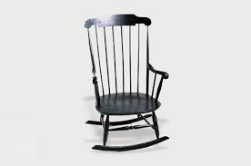
Is this useful?
Case #3

Slide 38
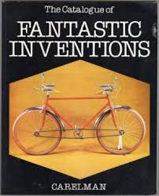
‘Manufrance’
Case #3
these two examples are from Jacques Carelman (1929-2012), an artist and designer, who developed Catalogue d'objets introuvables (1969) – a parody of catalog of the French mail order company ‘Manufrance’

Slide 39
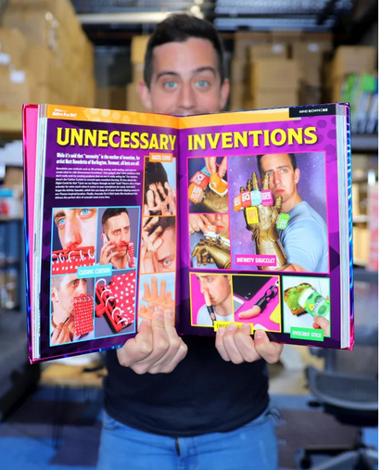
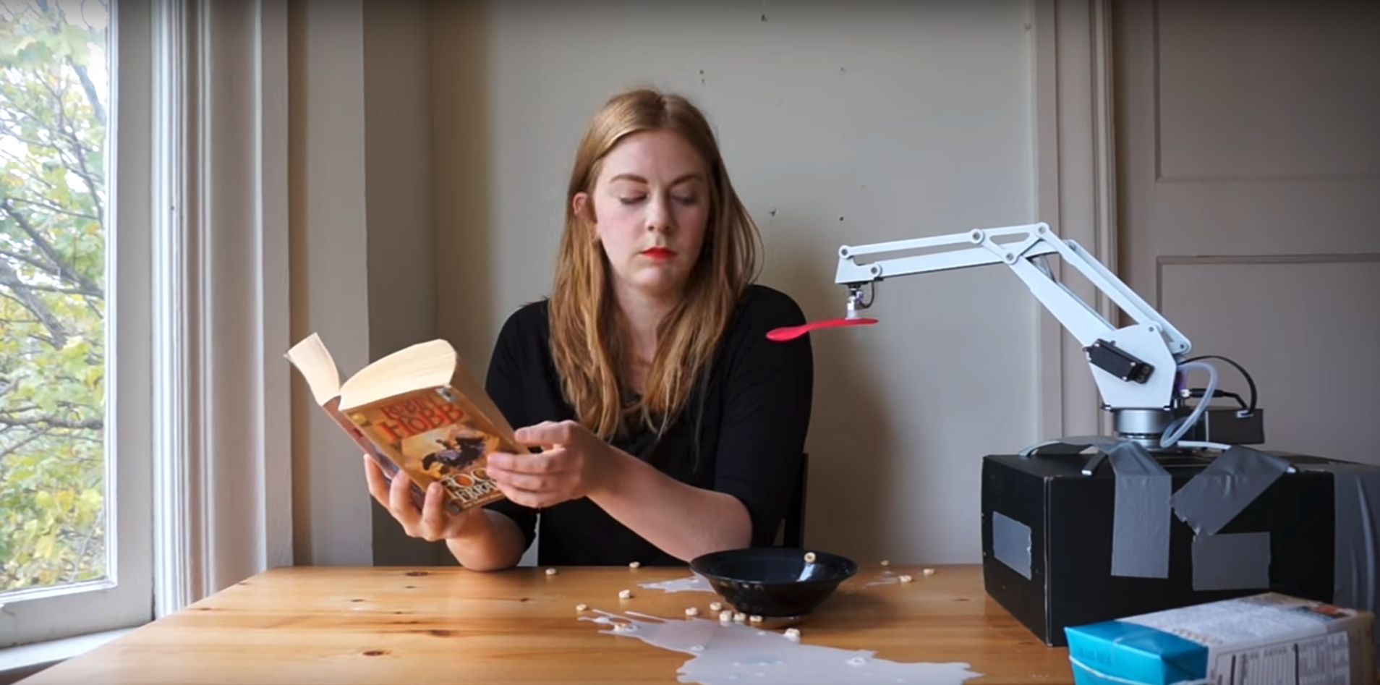
Parody
Case #3
r/UnnecessaryInventions u/rightcoastguy
The Breakfast Machine
Simone Gertz
https://www.youtube.com/watch?v=E2evC2xTNWg

Slide 40
Parody Design
Case #3
the designer may deliberately inscribe a ‘subversive’ script
a subversive script can be one that:
deliberately invokes ‘non use’
makes some kind of other point
engages in a social commentary (e.g., wastefulness, laziness)

Slide 41
Parody Design: Take-Aways
Case #3
the designer may deliberately inscribe a ‘subversive’ script, and yet is received by the user, where it then serves its purpose
the degree to which something is useful can depend to a large extent on the user, even with a subversive script
the designer is not the sole determinant of an artefact’s usefulness
the extent to which something is useful depends to a large extent on the user, irrespective of the ‘script’

Slide 42
Does the Designer Determine Usefulness?
In sum, usefulness is relational – usefulness is constructed between the artefact’s script and the user
the designer is not the sole determinant of an artefact’s usefulness
the extent to which something is useful depends to a large extent on the user

Slide 43
Does ‘Useful’ Imply Purpose or Goal?
are we assuming a task-oriented context?
not all interactive systems are task-oriented
think of systems used for pleasure and enjoyment, for entertainment, for being social, for emoting, etc
would we say these are useful systems?
there is a much broader context of user experience

Slide 44
Earlier Concepts of ‘Use’
in the early 1980’s, the first PC’s started to emerge
up to the 1990’s, digital interactive systems were not yet well established as mainstream consumer products
up until this point, the predominant concept of the ’use’ of digital technology was:
individualistic
tightly connected to workplace settings
tightly connected to specialized equipment (as opposed to mainstream consumer products)
tightly connected to ‘instrumental’ motivations
‘instrumental’ meaning use the program to get the job done as quickly, efficiently and correctly as possible
the concept of usability connected to this concept of use, and became strongly established

Slide 45
Shifting Concept of ‘Use’
starting about the mid 1990’s, digital technology grew into the form of consumer products, the WWW started to be established and then commercialized
the concept of ‘use’ started to shift, additional concepts of `use` arose, such as:
‘using’ for entertainment and for pleasure
‘using’ for communication (interpersonal and within communities)
as digital technologies have evolved, so has the use of these technologies
the concept of ‘use’ became broadened from the initial concept
the concept of usability didn’t connect well to this broadened concept of `use`, instead the concept of user experience came into use

Slide 46
Usefulness, In Sum
the usefulness of an interactive system emerges jointly from the user, their environment, and the affordances of the interactive system

Slide 47
5. What is meant by an affordance?

Slide 48
Systems and Their Elements
We already discussed the sociotechnical systems view: the elements in the sociotechnical system include the computational interactive systems and the humans (users), the system provides the context in which interaction takes place
Computational interactive systems:
Have articulators and sensors
Have ‘inner state’ (as determined via computational processes)
Are hardware-software systems
Humans:
Are biological systems
Have bodies with sensory-perceptual pathways
Have bodies with motor systems (and other systems for effecting action upon the world)
Have senses which are not passive (not solely in “inputs”) but rather active
Have cognition
Are meaning makers
Are social creatures

Slide 49
Human Action Within Their Environment
We want to delve further into the questions like:
why do humans do what they do when interacting with digital technologies?
how can we apply this knowledge towards the design of interfaces that will give rise to certain (desirable) outcomes and that will not give rise to other (undesirable) outcomes?
In investigating questions like this, a very useful concept is often employed – the concept of an affordance
This concept of an affordance is also important since it is foundational to our definition of interactive systems
an interactive system is a digital technology that affords interactivity to human users
So now we will discuss this concept

Slide 50
What is an affordance?
Before providing the characterization…
the concept of affordance is often misunderstood and misused (especially in the fields of HCI, UI, UX, IxD, etc)
we will cover the correct characterization here and distinguish the correct characterization from the mischaracterizations

Slide 51
Gibson
Gibson, a researcher in the field of psychology, originally defined the term affordance as follows:
Affordances are all "action possibilities" latent in the environment, objectively measurable and independent of the individual's ability to recognize them
James J. Gibson (1977), The Theory of Affordances. In Perceiving, Acting, and Knowing, edited by Robert Shaw and John Bransford, ISBN 0-470-99014-7.

Slide 52
Re: Gibson’s concept
Gibson’s concept of an affordance implies a separation of performability and perception
performability is the key factor
performability: whether or not a feature of the environment provides an "action possibility" to a particular individual
performability depends on the individual’s embodiment in relationship to the environment
different embodiments, different relationships
thus, performability is a relational term
perception is not part of establishing the action possibility
even in the individual fails to recognize an action possibility, if the action is performable by the individual, then that action possibility exists
the perceptibility of features is also relational

Slide 53
The Design of Everyday Things, Norman (2002)
Norman, D. A. (2002). The design of everyday things. New York: Basic Books. ISBN 0-465-06710-7.
About 25 years later (in 2002), Norman took core concepts from cognitive psychology and applied them to the domain of design
He took Gibson’s concept of an affordance and applied it to the practice of design:
“the term affordance refers to the perceived and actual properties of the thing, primarily those fundamental properties that determine just how the thing could possibly be used” (p. 9, 2002)
While this restatement is entirely incorrect, it is written in a way that led to many misunderstandings…

Slide 54
Mass Misuse of the Concept of Affordance
upon its publication in 2002, Norman’s book became hugely popular in fields such as HCI, UI, UX, IxD, etc
many practitioners took up the term ‘affordance’, but they misused and misunderstood the concept
instead of focusing on performability, the focus shifted to perception
instead of focusing on relational properties, the focus stayed on properties of the interactive system
Here is an example of the misuse
Preece (2002): affordance “is a term used to refer to an attribute of an object that allows people to know how to use it”
in all fairness, Norman could have been more careful (looking retrospectively)

Slide 55
The Design of Everyday Things (2nd Ed), Norman (2013)
Norman tried to correct the misunderstanding in the book’s second edition (2013)
In 2013, Norman noted:
the term affordance “created much confusion in the world of design”
"… the term became used in ways that had nothing to do with the original"
"Many people find affordances difficult to understand because they are relationships, not properties."
"Designers deal with fixed properties, so there is a temptation to say that the property is an affordance”
In the second edition (2013), he worked on correcting the misuse and clarifying

Slide 56
Ongoing misuse…
Despite Norman’s efforts to correct the misuse of the term affordance, the misuse continues
The mischaracterization is deeply entrenched
E.g. Preece (p. 30, 2019), still has in the section “Affordance” “This is a term used to refer to an attribute of an object that allows people to know how to use it.”

Slide 57
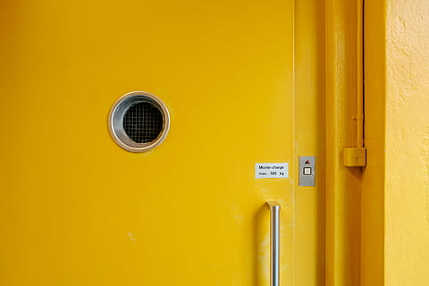
Door Example (I)
Say a door has a pull handle (and it is positioned at the chest level of a person of average height)
Person A
approaches on foot and perceives the pull handle visually.
knows that pulling on the pull handle will cause the door to swing on its hinges towards them (knowledge).
The handle affords pulling for person A.
Opening the door is an action possibility for person A.
The door affords ‘pullability’ for person A.
The possibility was latent in the environment (for Person A), independent of Person A’s ability to recognize it.
Perception of the possibility was visual, likely as the door designer envisioned

Slide 58
Door Example (II)
Say a door has a pull handle (and it is positioned at the chest level of a person of average height)
Person B
has a visual impairment and is not able to see the handle.
reaches out anyway, feels the handle, and then pulls on it.
The handle affords pulling for person B.
Opening the door is an action possibility for this person B.
The door affords ‘pullability’ for person B.
The possibility was latent in the environment (for Person B), independent of Person B’s ability to recognize it.
Perception of the possibility need not be visual and can be any manner of perception or discovery, even if the door designer did not anticipate it

Slide 59
Door Example (III)
Say a door has a pull handle (and it is positioned at the chest level of a person of average height)
Person C
uses a wheel chair and approaches the door, perceives the pull handle visually
reaches up but cannot reach it because it is too high
even it they could reach it, the door is too heavy and they can’t move their chair back while simultaneously pulling.
The handle does not afford pulling for person C.
Opening the door is not an action possibility for person C.
The door does not afford ‘pullability’ for person C.
The possibility was not latent in the environment (for Person C), irrespective of Person C’s ability to recognize it.
Activation of the action possibility will often be contingent on certain capabilities; designers often make implicit assumptions about the required capabilities

Slide 60
Door Example (IV)
Say a door has a pull handle (and it is positioned at the chest level of a person of average height)
Person D
has a visual impairment and is not able to see the handle
reaches out anyway, and, despite feeling for the handle, does not locate it
turns around and leaves the doorway
The handle affords pulling for person D.
Opening the door is an action possibility for this person D.
The door affords ‘pullability’ for person D.
The possibility was latent in the environment (for Person D), even though Person D did not recognize nor make use of the possibility.
Perception of the possibility need not be visual and can be any manner of perception or discovery. The designer can provision for this by providing cues and signals that are not likely to be missed.

Slide 61
Affording Interactivity
Now we have characterized affordances
This concept is important since it is foundational to our definition of interactive systems
an interactive system is a digital technology that affords interactivity to human users
The next resource pack will discuss interactivity and will compare it to reactivity

Slide 62
Affordance, In Sum
The sociotechnical systems approach focuses on the interaction between people and technology
In these systems, humans and computational interactive systems are the elements that stand in interaction with one another
The concept of affordance is a relational property, it captures the aspect of performability
The concept of affordance is different from the concept of perceptability

Slide 63
6. What is usability and how do we evaluate it?

Slide 64
Usability
the construct of usability in design is typically composed of several different aspects of use
this construct has its roots in the application of cognitive psychology to Human-Computer Interaction
there are many deconstructions, here is a common one [from Sharp et al 2019, §1.7.1 Usability Goals]
effectiveness
efficiency
safety
utility
learnability
memorability

Slide 65
Utility
Utility: to what extent does the system provides the range of desired functionality?
example of poor utility from the textbook
"a software drawing tool that does not allow users to draw freehand but forces them … to create their drawings using only polygon shapes"
does this not overlap with useful?
yes, it does
interpretive note:
utility makes sense in application domains where there is a sense of ‘incremental’ functionality for users in task-based activities (e.g., think of raster or vector graphics editing, photo editing, IDEs)

Slide 66
Effectiveness
Effectiveness: to what degree does the system allow the users to do what it is they need to do?
concerned with outcome, not effort or other attributes of the process
can I accomplish what I need to do (even if it takes me quite a lot of time, energy, frustration, …) ?

Slide 67
Does Effective Overlap with Useful?
yes, there is overlap…
the term usability is an overarching concept developed in a scholarly research community
connected to the scholarly discipline of HCI, emerging in the 1980’s
this discipline assumed a functional, task-based context of use
the term useful is a word in everyday use
is now connected to the the UI/UX grey literature
often gets used within the ‘contrasting trio’ of “useful, usable, used”

Slide 68
Efficiency
Efficiency: how much effort is required to derive the desired outcome?
concerned with process: to achieve a particular outcome (effectiveness), how much time and/or energy goes into getting that outcome?
need to factor out the effort that goes into learning, since this is a separate aspect of usability
thus, this question is typically posed as “how much effort is required to derive the desired outcome, once users have already learned the system?

Slide 69
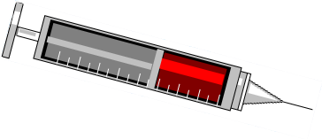
Illustration: An interface for specifying the dose of medication
Which is safer?
13672
7
8
9
1 3 7 2
4
5
6
+
+
+
+
1
2
3
0
-
-
-
-
Interface A
Interface B

Slide 70
What is “User Mistake”
user did the ‘wrong’ thing … usually meaning ‘different from what they intended’ … an ‘inadvertent error’
users can make mistakes for many different reasons: incorrect assumptions, mistaken beliefs, inattention, motor error
mistakes are connected to both effectiveness and efficiency
detecting and correcting mistake (assuming they can be corrected) takes time and energy … this is a detriment to efficiency
if errors cannot be corrected … this is a detriment to effectiveness
mistakes are inevitable, it is difficult to imagine all of the mistakes that will happen…

Slide 71
Safety
Safety: Is the user protected from negative consequences from user mistake?
given all possible user actions at a point in time, what are the possible of outcomes and their consequences?
are there ‘dangers’ in some of these consequences
e.g., creation of hazards, loss of data and/or previous work, …
for these dangerous actions, are there means of recovery?
this aspect is concerned with helping any kind of user in any kind of situation to avoid making mistakes and/or to recover from mistakes

Slide 72
Expensive Mistakes
actions can be ambiguous – was this action a mistake or was it deliberate?
if the consequence of the action is easily reversed…
then if it was a mistake, at least it wasn’t an expensive mistake
if the consequences that cannot be easily reversed…
it a mistake expensive or inexpensive?
expensive mistakes include:
operations that use up a lot of computing time
operations that use up a lot computing resources (bandwidth, fill up the disk space, etc)
operations that cause loss of data and/or previous work

Slide 73
High-Stakes Actions
if a user performs a high-stakes action (serious consequence)
this could mean an expensive mistake
a good strategy is to verify…
a common form of safeguard is a verification step
this can mitigate consequences of user actions made in error by requiring the user to confirm the action

Slide 74
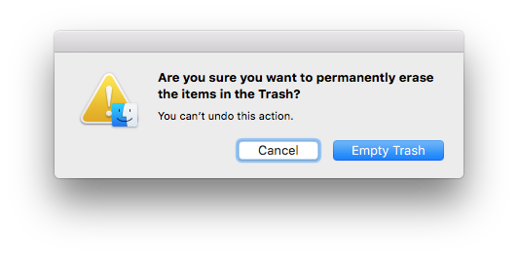
Example: Disk Operations
for example, some file system operations can be non-recoverable

Slide 75
Safeguards vs Efficiency
the verification step is a “mixed blessing”
requiring the user to confirm the action is a small step to avoid an expensive mistake
requiring the user to confirm non-mistaken actions can cost unnecessary time and effort for actions not made in error
thus, there can be a tradeoff with efficiency
when is safety a good tradeoff with efficiency?
it really does depend on the tradeoff among the likelihood of the error, the magnitude of the consequence, and the frequency of the actions
thus, safeguards improve safety, but safeguards can stand in tension with efficiency

Slide 76
Learnability
Learnability: the extent to which the users can easily figure out how to use the system from the outset
learnability is connected to the complexity of system
can the user employ their own strategies?
most often, the user’s strategy is exploration
is a particular mode of learning enforced?
e.g., guided walk-throughs (wizards), documentation, tutorials, videos, exploration, …
users are mostly* intolerant of time-intensive learning
can learning be measured?
yes, learning can be operationalized
requires pre/post probes, and a retention probe as well

Slide 77
Memorability
Memorability: the extent to which users can remember how to use the system, particularly after a pause
implies a context of use in which learning has already taken place
the poorest memorability outcome would be a system that has to be relearned from scratch every time
a system may provide some prompts to help users remember

Slide 78
Useful vs Usable
think in terms of separating the ‘what’ from the ‘how’
useful: the 'what'
allows user to accomplish task or objective (the 'what')
usable: the 'how'
characterizes things like…. and here it depends on how you define ‘use’:
objectively measurable things:
productive, low-effort, safe, easy to learn, easy to remember …
subjective aspects:
enjoyable, pleasurable, and so on…

Slide 79
In Sum
usable is different from useful
usable and useful are connected to task-based contexts
think of useful as the 'what’, and usable as the 'how’
an interactive system be useful but not usable, and an interactive system be usable but not useful

